Slide 1
Full name, student number

Slide 2
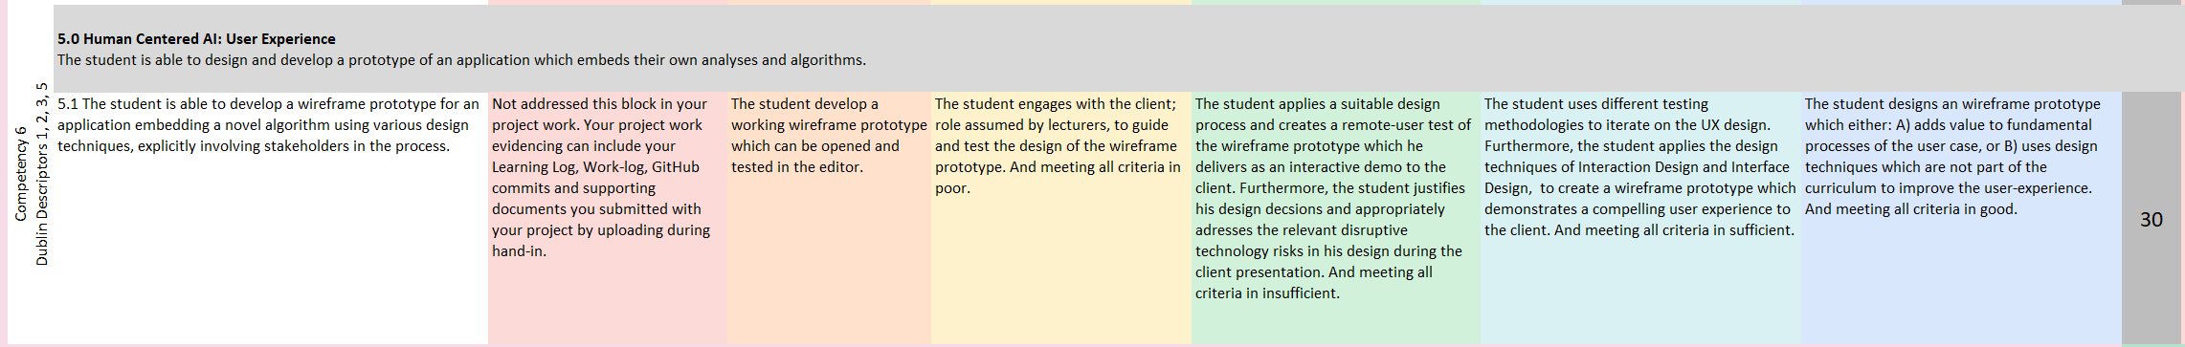
Guide of use
The presentation is part of the summative assessment of HCAI
Go more into detail for HCAI, use the assessment rubric as a ‘tickbox’ to creating the “Prototype” section:
The presentation is formative (= no assessment) for all other ILO’s
Keep your presentation brief and high-level for all sections other than Prototype
Tip: See it a viability study/developer’s journey for the prototype, it helps to create a story (and remember how we should tell story with our data?); helps even if you prototype and algorithms don’t quite match
Detailed descriptions or supplementary material you (might) want to show but can’t put in? Add it at the end of the presentation: for after or during the Q&A
Delete this slide before presenting

Slide 3
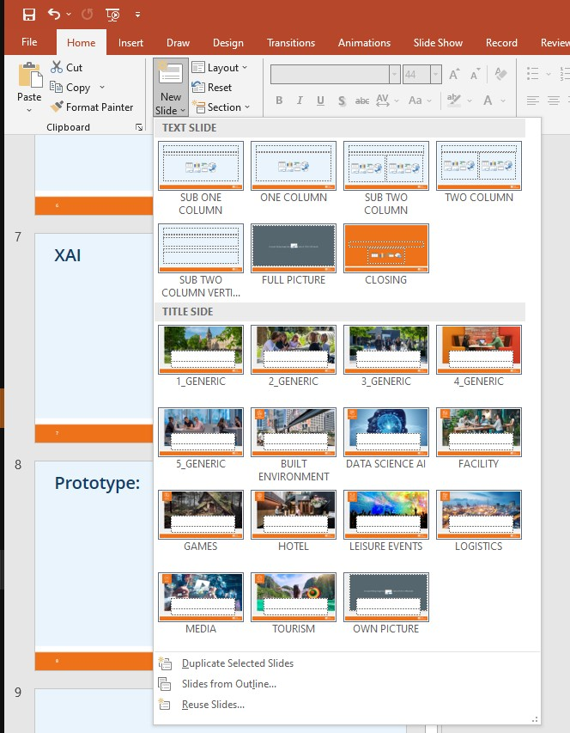
Guide of use
You have the creative freedom to use any other powerpoint presentation style or formatting but stick with the structure and presentation contents
But feel free to use this one, makes your life easy:
Delete this slide before presenting

Slide 4
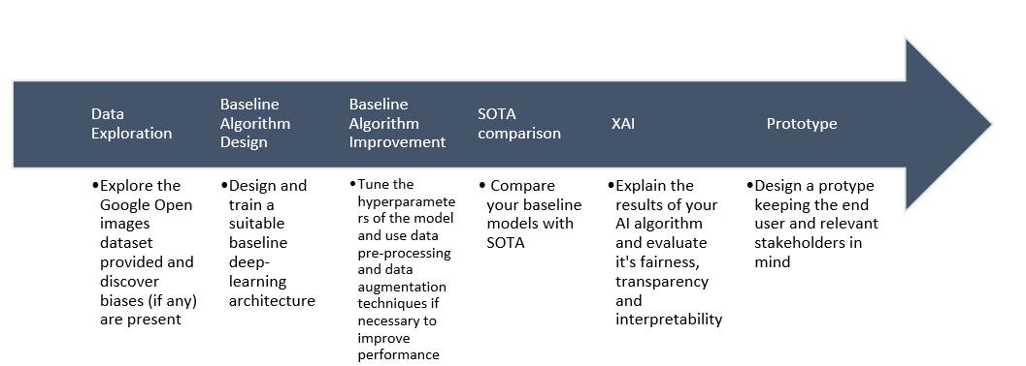
Table of Contents
Data Exploration
Baseline Algorithms Design
Baseline Algorithms Improvement
SOTA Comparison
XAI
Prototype
Block Reflection
Q&A
Delete this slide before presenting

Slide 5
Data Exploration
[Briefly walk us through what you did]

Slide 6
Baseline Algorithm Design
[Briefly walk us through what you did]

Slide 7
Baseline Algorithm Improvement
[Briefly walk us through what you did]

Slide 8
SOTA Comparison
[algorithm A vs algorithm B]
A
B

Slide 9
XAI
Briefly walk us through what you did

Slide 10
Prototype
Who is the User? Problem(s) & Solution(s)

Slide 11
Prototype: [name]
Some information about your application...
Design
Images? Extra stuff?

Slide 12
Wireframe Prototype Demostration
Interactive demo:
QR-code, Link, stakeholders will use your device?
Video of you giving a demo?

Slide 13
Block Reflection
One achievement...
Brief will do, but up to a minute if you feel like it

Slide 14
Block Reflection
One challenge...
Brief will do, but up to a minute if you feel like it

Slide 15
Block Reflection
One import lesson...
Brief will do, but up to a minute if you feel like it

Slide 16
Q&A
Thank you!
Any questions?

